Slide 1
Introduction to Asymmetric Cryptography

Slide 2
Asymmetric cryptography
M plaintext
C ciphertext
Plaintext M
SRC
Ciphertext C
DST
Plaintext M
C=ENC(K_{ENC}, M)
M=DEC(K_{DEC}, C)
K_{ENC}
K_{DEC}
K_{ENC} encryption key
ENC(.) encryption algorithm
K_{DEC} ≠ K_{ENC} decryption key
DEC(.) decryption algorithm
Encryption and decryption keys are obviously linked…
But CANNOT be determined from each other
(unless you know ‘more’)

Slide 3
Practical usage model #1: HTTPS/TLS-style
First phase: handshake
Signalling phase, sets up shared secret using asymmetric cryptography
Second phase: data transfer
Derives symmetric encryption and message authentication keys from shared secret derived in first phase (use KDF, more later)
Further phases: rekeying + data transfer
«refresh» symmetric encryption and message authentication keys still using shared secret derived in first phase (use KDF with different nonces)
Initial
handshake
Abbreviated
handshake
Includes auth
TCP conn
TCP conn
time
TLS SESSION

Slide 4
Practical usage model #2: Hybrid Encryption
Generate (random) symmetric key K
Use key K and symmetric cipher to encrypt (long) data
Encrypt K with ASYMMETRIC cipher, and send it with message
Long message m
ordinary simmetric
cipher (e.g., AES)
Key K
asymmetric
cipher
Long message m
Key K
SEND
(ECIES: recently introduced in 5G subscriber Identity Concealment – see 5G SUCI)

Slide 5
PubKey crypto: two ways to use it
ENC and DEC are inverse operations: DEC(ENC(M))=M
assume commutativity: also ENC(DEC(M))=M
Public key encryption: anyone can encrypt M, but only B can decrypt
ANY A
E_{B}(M)
B
D_{B}(E_{B}(M))=M
M
encrypt
decrypt
E_{B}
D_{B}
Digital signature: DUAL approach! Only A has K_{DEC} → can apply DEC (sign)
but anyone else has K_{ENC} → can apply ENC (verify)!
A
ANY B
E_{A}(D_{A}(M))=M
M
sign
verify
D_{A}
E_{A}

Slide 6



digital signature
Public Key
PK
M = «780 EUR per te»
H(M)
Use SK
Private Key SK
Is it valid?
Get PK
(it’s public!)
M = «780 EUR per te»
H(M)
Use SK

Slide 7
digital signature
Public Key
PK
M = «780 EUR per te»
H(M)
Use SK
Private Key SK
Is it valid?
Get PK
(it’s public!)
M = «780 EUR per te»
H(M)
Use SK
Use PK to «invert» tag
Do they match?
If Y, message is valid

Slide 8
Digital signature: message integrity with source authentication
Message integrity → auth tag
Symmetric MAC (e.g. HMAC):
K = symmetric key: shared by SRC and DST
DST must know SRC key = same key K to verify
Digital Signature
K = SRC private key
DST just needs to know SRC PubKey to verify!
Consequence: non-repudiation a.k.a. source authentication
SRC
DST
message M
TAG(K,M)

Slide 9
Anymmetric Cryptography: Basic Algorithms

Slide 10
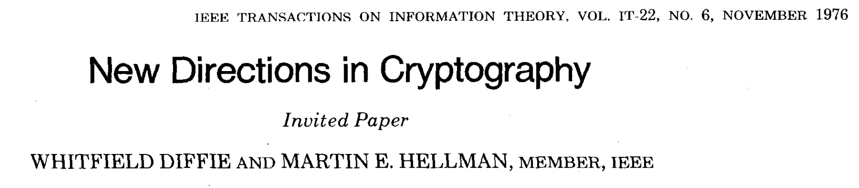

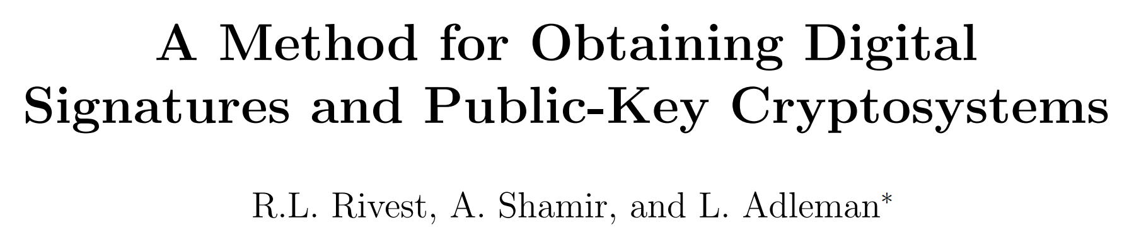
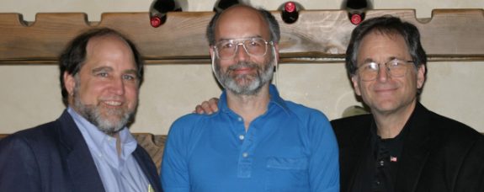
The Pioneers
1976: invention of asymmetricy crypto
First-ever asymmetric algorithm: Diffie-Hellman KEY AGREEMENT
1977: first ever public key encryption & digital signature:
RSA crypto system

Slide 11
Basic ingredient: HARD (asymmetric) PROBLEM
Problem computationally EASY in one direction, but computationally HARD in the opposite direction
Diffie-Hellman:
DISCRETE LOGARITHM PROBLEM IN PRIME FIELDS
Given large prime p, g, x, compute y = g^{x} mod p → easy
Given y = g^{x} mod p compute x = DLog_{g}(y) mod p → hard!!
RSA:
FACTORING A PRODUCT OF TWO LARGE PRIMES
Given p and q large primes, compute N=p q → easy
Given N, find factors p, q → hard

Slide 12
Why modular exponentiation is easy
Goal: compute g¹⁴³⁷ mod p
Express x in bits
1437₁₀=10110011101₂
list bits from lsb to msb
First line: initialize
Column Square = g
Column Multiply = 1 (if b=0) or g (if b=1)
Start from 2° lsb to msb
For every bit
Square;
If 1: multiply to result
Complexity:
O(nbit) x2
O(nbit/2) additions

Slide 13
Why modular exponentiation is easy
Goal: compute g¹⁴³⁷ mod p
Express x in bits
1437₁₀=10110011101₂
list bits from lsb to msb
First line: initialize
Column Square = g
Column Multiply = 1 (if b=0) or g (if b=1)
Start from 2° lsb to msb
For every bit
Square;
If 1: multiply to result
Complexity:
O(nbit) squares
O(nbit/2) multiplications
No algorithm such as this for the opposite problem!! That’s why it is hard!

Slide 14
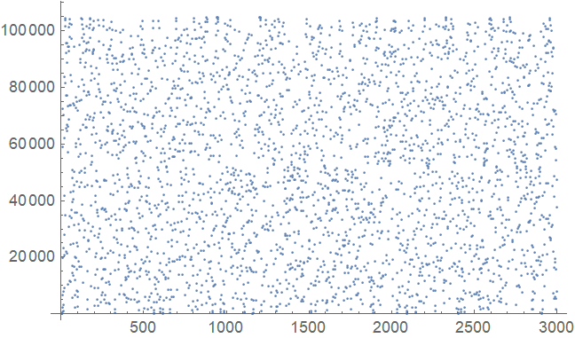
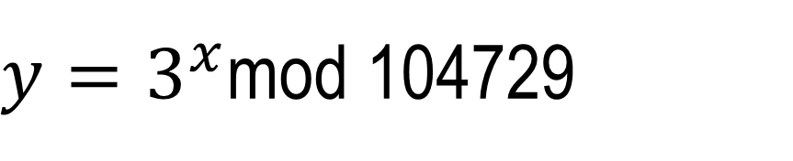
And why DLOG is hard
$y=3^{x}$mod 104729
y=33490; x?
x=1999 → can find only brute force

Slide 15
Diffie-Hellman Key Agreement
Diffie-Hellman protocol, 1976
Main crypto breakthrough in the last century
Invention of asymmetric cryptography
Though did NOT solve the PubKey cryptosystem problem
RSA solved it in the next year (1977)
What DH is: KEY AGREEMENT protocol
How to securely setup a shared secret (i.e., a symmetric key) at both ends, by only exchanging public values
i.e., WITHOUT having a secure channel
Hard problem used in DH: DLOG

Slide 16



Diffie-Hellman Key Agreement
Alice
Bob
SEND g^{x} mod p
Random x
Random y
SEND g^{y} mod p
COMPUTE K=(g^{y})^{x} mod p
COMPUTE K=(g^{x})^{y} mod p
K=g^{xy}: SAME KEY
at both ends!
K=g^{xy}: SAME KEY
at both ends!
Wait, I see all the exchange!!
From g^{x},g^{y} → hard to compute g^{xy}
Attacher must necessarily invert DLOG for one of the two terms: computationally hard!!

Slide 17
DH functional limitation
Does NOT implement neither a public key cryptosystem
You cannot «transfer» data encrypted with the receiver’s PK
nor a digital signature!
You cannot sign data using your SK
1977: RSA to the rescue!

Slide 18
The RSA algorithm
Rivest, Shamir, Adleman, 1977
Patented until 2000
Widely deployed! Ultra-well known
HARD (asymmetric) PROBLEM USED: prime number factoring
Given N = p × q (p, q very large primes) HARD to «factor» N (= find the two values p, q)
Encrypt/decrypt: modular exponentiation
ENC(message, {N, PK}) → ciphertext = (message)^{PK} mod N
DEC(ciphertext, {N,SK}) → message = (ciphertext)^{SK} mod N
Can support both encryption and digital signature

Slide 19
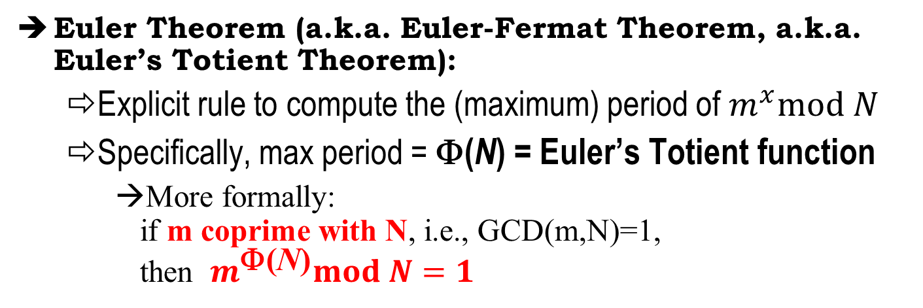
The principle behind RSA
$$m^{x}mod N is a periodic function$$
$$3^{x}mod 10=\left\{3,9,7,1,3,9,7,1,…\right\}$$
$$7^{x}mod 10=\left\{7,9,3,1,7,9,3,1,…\right\}$$
$$9^{x}mod 10=\left\{9,1,9,1,9,1,9,1,…\right\}$$
Euler Theorem (a.k.a. Euler-Fermat Theorem, a.k.a. Euler’s Totient Theorem):
Explicit rule to compute the (maximum) period of $m^{x}mod N$
Specifically, max period = Φ(N) = Euler’s Totient function
More formally: if m coprime with N, i.e., GCD(m,N)=1, then $m^{\text{F}\text{(}\text{N}\text{)}}mod N=1$

Slide 20
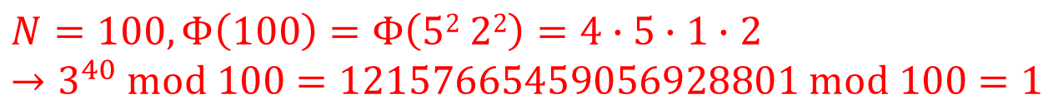
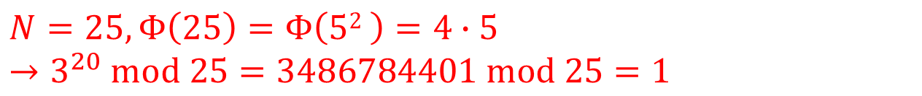
Computing Euler’s Totient Function
p prime → Φ(p) = p-1
$${p=7, Φ\left(7\right)=6 → 3}^{6}mod 7=729 mod 7=1$$
p,q primes → Φ(p·q) = Φ(p)·Φ(q) = (p-1)(q-1)
RSA case
$${N=10, Φ\left(10\right)=4 → 3}^{4}mod 10=81 mod 10=1$$
Prime p^{k} → Φ(p^{k}) = Φ(p)·p^{k-1} = (p-1) p^{k-1}
$${N=25, Φ\left(25\right)=Φ\left(52 \right)=4∙5 }^{}$$
$$→3^{20} mod 25=\text{3486784401} mod 25=1$$
$general case$:$N=p_{1}^{k_{1}}∙…∙p_{z}^{k_{z}}$
$$Φ\left(N\right)={(p}_{1}−1)p_{1}^{k_{1}−1}∙{…∙(p}_{z}−1)p_{z}^{k_{z}−1}$$
$${N=100, Φ\left(100\right)=Φ\left(52 22\right)=4∙5∙1∙2 }^{}$$
$$→3^{40} mod 100=\text{12157665459056928801} mod 100=1$$

Slide 21
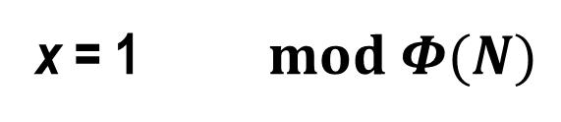
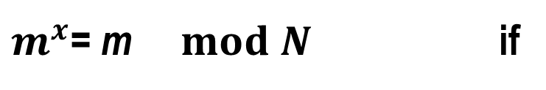
Consequence of «periodicity»
$$m^{x}mod N is a periodic function with period Φ\left(N\right)$$
$2^{x}mod 11=\text{\{2,4,8,5,10,9,7,3,6,1\}} Φ\left(11\right)$=10
Compute 9·7 mod 11=?
Using multiplications mod 11 → 9·7 mod 11= 63 mod 11 = 8
Alternative approach: since 9=2⁶ mod 11 and 7=2⁷ mod 11:
9·7 mod 11= 2⁶·2⁷ mod 11 = 2⁶⁺⁷ mod 11 = 2¹³ mod 11 = …
… = 2¹⁰⁺³ mod 11 = 2³ mod 11 = 2¹³ ^{mod10} mod 11
→ arithmetic @ exponent = modulo Φ(N), not N!!!
Consequence:
$m^{x}$= m $mod N$ if
x = 1 $mod Φ(N)$

Slide 22
RSA construction
Generate two LARGE primes p, q (must remain SECRET!)
Compute RSA module: N = p × q (can be made public!)
Compute Φ(N) = (p - 1)(q - 1) (must remain SECRET!)
Generate public key 1<e < Φ(N) e must be coprime with Φ(N)
Generate private key d such that e × d =1 mod Φ(N) possible only if e invertible mod Φ(N) → that’s why e coprime with Φ(N)
Security assumption: given N, must be hard to find factors p, q
→ hence hard to find Φ(N)
→ an without Φ(N) hard to compute d from e
(N, e)
d
Pubic key
Private Key

Slide 23
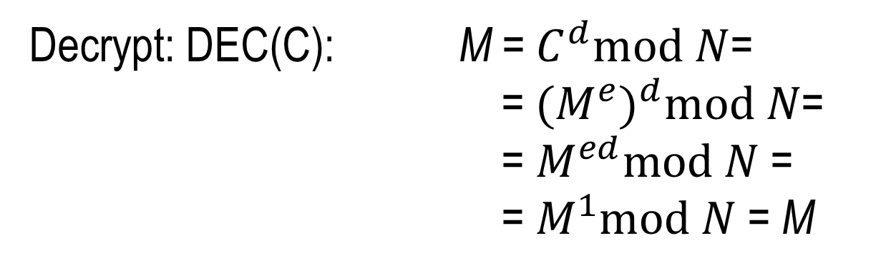

RSA construction
(N, e)
d
Public key
Private Key
Encrypt: ENC(M): C =$M^{e}mod N$
Decrypt: DEC(C): M =${ C}^{d}mod N$=
=${{ (M}^{e})}^{d}mod N$=
= $M^{ed}mod N$ =
= $M^{1}mod N$ = M

Slide 24
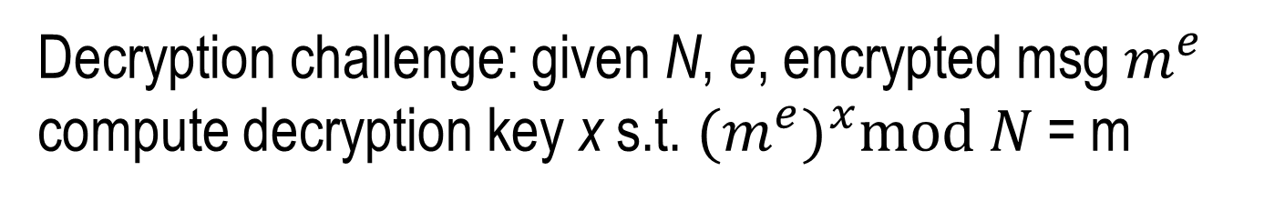
Why RSA works? Trapdoor function!
Decryption challenge: given N, e, encrypted msg $m^{e}$ compute decryption key x s.t. ${{(m}^{e})}^{x}mod N$ = m
Normally: HARD problem
→ exponential complexity (brute force on possible values x)
Becomes EASY when you know Φ(N)
→ Equation e · x mod Φ(N) can be solved in polynomial time
x = e⁻¹ mod Φ(N)
modular Inverse← Extended Euclidean Algorithm

Slide 25
Reminder: Ext Euclidean algo
GCD[51,11]=1 coprime
Find a,b s.t. 51 a + 11 b = 1
a
b
val
rem
1
0
51
0
1
11
4
Subtract 4x
1
-4
7
1
Subtract 1x
-1
5
4
1
Subtract 1x
2
-9
3
1
Subtract 1x
-3
14
1
=
51x(-3)+11x(14)=1

Slide 26
How to compute RSA inverse
Public key: e
Example: e=13
RSA modulus: 77=11×7
Φ(77)=10×6=60
GCD(e, Φ)=1 (coprime, OK)
Find a,b such that Φ a + e b = 1
ExtendedGCD[60,13]={1,{5,-23}}
60 × 5 + 13 × (-23) = 1 → 13 × (-23) = 1 - 60 × 5
Mod[13 × (-23), 60] = Mod[1 - 60 × 5, 60] = 1
Hence 13⁻¹ mod 60 = -23 = 37

Slide 27
RSA recap: toy example
p = 11, q = 17 (secret)
N = p×q = 11×17 = 187 (public)
Φ = (p–1)×(q–1) = 10×16 = 160 (secret)
e = 7 (public, prime wrt 160)
d = 7⁻¹ mod 160 = 23 (secret)
Note: 23×7 ≡ 161 = 160+1 = 1 (mod 160)
Public Key Encryption: C=M⁷ mod 187
Decrypt: (M⁷)²³ mod 187= M^{7x23} mod 187= M
Digital Signature: send M, TAG=H(M)²³ mod 187
Verify sign: TAG⁷ mod 187= (H(M)²³)⁷ mod 187= H(M)
check hash matches with message M provided

Slide 28
Digital Certificates and Public Key Infrastructure

Slide 29
digital signature: review
Public Key
PK
M = «780 EUR per te»
H(M)
Use SK
Private Key SK
Is it valid?
Get PK
(it’s public!)
M = «780 EUR per te»
H(M)
Use SK

Slide 30
digital signature: review
Public Key
PK
M = «780 EUR per te»
H(M)
Use SK
Private Key SK
Is it valid?
Get PK
(it’s public!)
M = «780 EUR per te»
H(M)
Use SK
Use PK to «invert» tag
Do they match?
If Y, message is valid

Slide 31

digital signature: problem
Mmmmh, Let me try to break this
Public Key
flaviaPK
Public Key
gbPK
Private Key flaviaSK
I’m Flavia,
here is my PK: gbPK
Private Key gbSK
Is it valid?
Get Flavia PK
(it’s public!)
M’ = «7800 EUR per te»
H(M’)
gbSK
OK, The PK that Flavia (??!!) gave me matches this signature, the message is valid (!!)

Slide 32
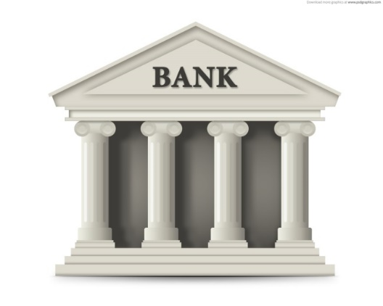
RSA Key Transport, review
Flavia wants to access her bank account using a secure communication
A
Hello dear, would you mind sending me you PK?
Here you are: BankA→ pk_{bankA}
choose
random K
Here is the secret key we’ll use in our session: ENC(K, pk_{BankA})
Data exchange: encrypted with symmetric key K

Slide 33
RSA Key Transport, MITM attack
A
Hello dear, would you mind sending me you PK?
I’m BankA, this is pk_{bankA}
I’m BankA, this is pk_{badguy}
choose
random K
Here is key: ENC(K, pk_{badguy})
Here is key: ENC(K, pk_{bankA})
I have K!!
Data exchange: encrypted with symmetric key K

Slide 34


What about DH? MITM, again!!
Alice
Eve!
Bob
choose random
x ∈ {0,1}^{s}
choose random
y ∈ {0,1}^{s}
(g^{x}) mod p
(g^{z}) mod p
(g^{z}) mod p
(g^{y}) mod p
K₁ = (g^{xz}) mod p
K₂ = (g^{yz}) mod p
Data exchange: encrypted with K1
Data exchange: encrypted with K2

Slide 35

Three different scenarios, SAME problem!! We need a way to ‘cryptographically bind’ a public key to an identity!
I’m Flavia, my public key is 876543
NO
YOU’RE NOT,
I CAN
SPOT YOU
I’m Flavia, my public key is 876543

Slide 36
The solution: Digital Certificates

Slide 37
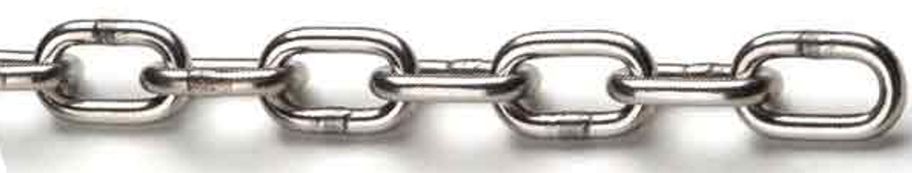
Main Role of a digital certificate
To Bind a public key to a subject
A person, a company, a legal entity, …
Cryptographic binding
Digital signature by a TRUSTED THIRD PARTY: a “certification Authority” that guarantees integrity of the binding
Subject NAME
Subject Public Key

Slide 38
Why we need certificates?
User X knows ALL public keys of all remaining users
No need for certificates (direct trust model)
BUT: unviable, does not scale
User X trusts TTP, who guarantees for other users
Public Key Infrastructure

Slide 39
A) Issuing a Certificate (offline)
CERTIFICATION
AUTHORITY
4
CERT = (BankName, BankPK)_{CA_sign}
3
Here is my BankName and here my PK
(via secure channel)
CERT = (BankName, BankPK)_{CA_sign}
SK
1
Generate PK and SK pair
2
Store SK locally (never diclosed or TXed!)

Slide 40
B) Verifying Certificate validity
CERTIFICATION
AUTHORITY
1
Here I am: name and PK
(BankName, BankPK)_{CA_sign}
CERT = (BankName, BankPK)_{CA_sign}
SK
2
Do I trust the CA you have chosen?
(Is in my list of trusted ones?) → OK
DOES THIS MEAN THAT I’M REALLY TALKING TO THE BANK?
3
Is the CA signature correct? → OK

Slide 41
B) Verifying Certificate validity
CERTIFICATION
AUTHORITY
Here I am: name and PK
(BankName, BankPK)_{CA_sign}
CERT = (BankName, BankPK)_{CA_sign}
SK
DOES THIS MEAN THAT I’M REALLY TALKING TO THE BANK?
3
Is the CA signature correct? → OK
NOT YET – what about cert replay?!

Slide 42
B) Verifying Certificate validity
CERTIFICATION
AUTHORITY
SK
TWO WAYS TO DO THIS:
Ask Bank to sign something fresh
Ask bank to decrypt something fresh
4
Let’s «ask» the bank to PROVE possession of the private key SK associated to the cert!

Slide 43

Proof of knowledge of SK via digital signature
Certificate(BankName, BankPK)_{CA_sign}
Generate fresh
NONCE
(challenge)
Prove knowledge of SK by signing a fresh NONCE
(NONCE)_{Bank_sign}
If bank signature «opens» with certificate PK, then Bank is authenticated!

Slide 44
Proof of knowledge of SK via PubKey encryption
Certificate(BankName, BankPK)_{CA_sign}
Generate fresh
NONCE
(challenge)
Prove you know SK by decrypting this: ENC (NONCE)_{Bank_PK}
Here you are: NONCE
If bank returns «decrypted» NONCE then Bank is authenticated!

Slide 45
Practical TLS approach (when RSA Key Transport used)
Certificate(BankName, BankPK)_{CA_sign}
Generate fresh
Key K
ENC (key K)_{Bank_PK}
Data exchange: encrypted with symmetric key K
Bank can communicate only
if it is Authentic!! If Rogue/MITM, cannot decrypt key K

Slide 46

Certificate chains
UNIVERSETRUST
LUNATRUST
LUNATRUST? Not in my list of trusted.
Who «certifies» LUNATRUST?
UNIVERSETRUST: OK, this is in my list, let’s go on!
CERTIFICATE(BankName,PK)_{LUNATRUST}

Slide 47
Very brief intro to PKI Public Key Infrastructure

Slide 48
Public Key Infrastructure (PKI)
A PKI specifies protocols, policies, and technical mechanisms needed to support exchange of public keys
A PKI architecture requires:
Standard format for certificates
Relation among CAs, and with end users
Policies for issuing and REVOKING (!!) certificates
Directory services
Typical certificate format: X.509

Slide 49
X.509 certificates (high level)
Standard version,
Temporal validity,
Unique serial number,
Algorithms, etc
CA identity
User identity
Public key of user
Digital signature by the CA

Slide 50


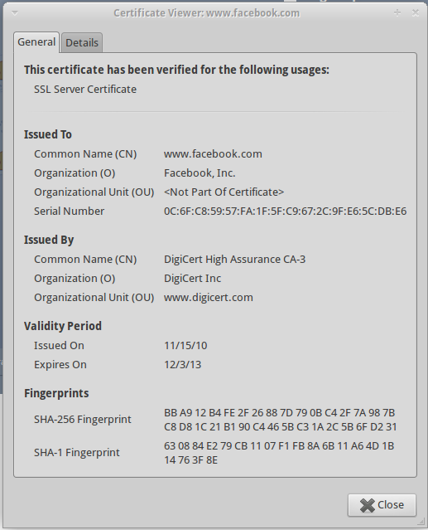
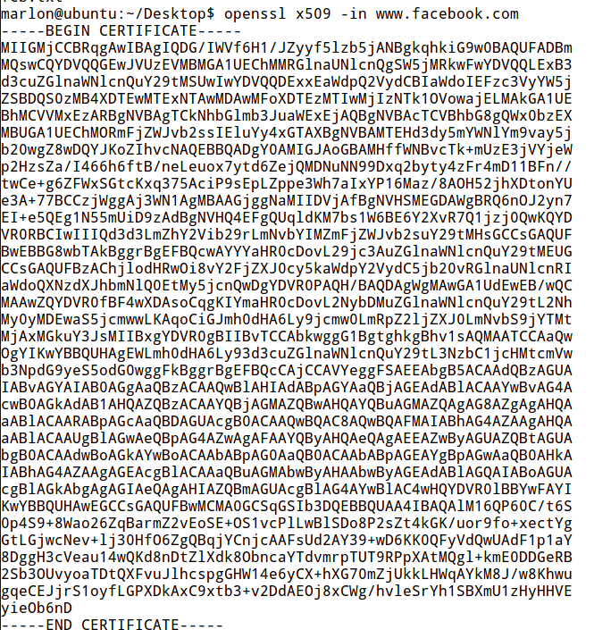
X.509 certificates: a real example

Slide 51
X.509 certificates: a real example
Version: 3 (0x2)
Serial Number:
0c:6f:c8:59:57:fa:1f:5f:c9:67:2c:9f:e6:5c:db:e6
Signature Algorithm: sha1WithRSAEncryption
Issuer: C=US, O=DigiCert Inc, OU=www.digicert.com, CN=DigiCert High Assurance CA-3
Validity
Not Before: Nov 15 00:00:00 2010 GMT
Not After : Dec 2 23:59:59 2013 GMT
Subject: C=US, ST=California, L=Palo Alto, O=Facebook, Inc., CN=www.facebook.com
Subject Public Key Info:
Public Key Algorithm: rsaEncryption
RSA Public Key: (1024 bit)
Modulus (1024 bit):
00:c1:df:7d:63:41:bd:c4:e4:fa:65:33:13:78:d5: (... deleted …) 0b:38:d6:82:00:23:dd:63:75
Exponent: 65537 (0x10001)
X509v3 extensions: (deleted)
X509v3 Subject Key Identifier:
AA:57:4A:33:B6:EC:D5:6E:81:13:A6:36:5E:F4:7B:43:58:F3:8F:44
X509v3 Subject Alternative Name:
DNS:www.facebook.com, DNS:facebook.com
X509v3 Key Usage: critical
Digital Signature, Key Encipherment
X509v3 Basic Constraints: critical
CA:FALSE
X509v3 Extended Key Usage:
TLS Web Server Authentication, TLS Web Client Authentication
Signature Algorithm: sha1WithRSAEncryption
25:33:5e:90:3f:ad:02:fe:de:92:d2:9e:12:f7:ef:16:6a:8d: (... deleted …) 8e:6f:a9:c3

Slide 52
Public Key Cryptography Standards
PKCS family
PKCS #1 -- #15
Some obsoleted
Standardize many PKI related aspects (and more)
PKCS#1: RSA
PKCS#3: DH
PKCS#13: ECC
PKCS#6: X.509 extensions
PKCS 10: Certification Request Syntax Standard
PKCS 11, 15: Cryptographic Token Interface Standard - API for signing and verifying data by a device that holds the key
PKCS 12: Personal Information Exchange Syntax Standard - file format for storing certificate and private key - used to move private information between browsers

Slide 53
Example: Certificate Signing Request
A certificate signing request (also CSR or certification request) is a message sent from an applicant to a certificate authority in order to apply for a digital identity certificate
The most common format for CSRs is the PKCS#10 specification
Operations:
the applicant first generates a key pair, keeping the private key secret
the applicant generates a CSR contains information identifying herself (X.509 subject field), optional X.509 extensions (e.g. key usage: RSA authentication for web servers) and the public key chosen by the applicant
The CSR may be accompanied by other credentials or proofs of identity required by the certificate authority, and the certificate authority may contact the applicant for further information

Slide 54
X509v3 extensions
An X.509 v3 certificate contains an extension field that permits any number of additional fields to be added to the certificate
Certificate extensions provide a way of adding information such as alternative subject names and usage restrictions to certificates

Slide 55
Some standard extensions
Authority Key Identifier
The authority key identifier extension provides a means of identifying the public key corresponding to the private key used to sign a certificate
Subject Key Identifier
The subject key identifier extension provides a means of identifying certificates that contain a particular public key
Key Usage
The key usage extension defines the purpose (e.g., encipherment, signature, certificate signing) of the key contained in the certificate.
digitalSignature, nonRepudiation, contentCommitment, keyEncipherment , dataEncipherment, keyAgreement, keyCertSign, cRLSign, encipherOnly, decipherOnly
Subject Alternative Name
The subject alternative name extension allows identities to be bound to the subject of the certificate. These identities may be included in addition to or in place of the identity in the subject field of the certificate
Extended Key Usage
This extension indicates one or more purposes for which the certified public key may be used, in addition to or in place of the basic purposes indicated in the key usage extension.
TLS WWW server authentication, TLS WWW client authentication, Signing of downloadable executable code, Email protection, Timestamping
See http://tools.ietf.org/html/rfc5280 for the complete list

Slide 56
Certificate revocation
A PKI MUST include mechanisms for handling compromised certificates!
Examples:
Public keys whose private keys have been disclosed
Public keys whose private keys have been lost
Public keys not anymore used
Two major (and coexisting) approaches
Validity period for a certificate
Explicit revocation
Classical analogy: a credit card

Slide 57
Revocation approach: Certificate Revocation List (CRL)
EVERY CA must regularly publish a list of certificates the CA has revoked
List format: must include
Issuer, Last update date, Next update date
List of serial numbers revoked, along with revocation date
CA digital signature
In principle, you SHOULD verify that the certificate of the site you are accessing has NOT been revoked
Overhead:
Online access, or offline periodic download of CRL
In practice… frequently overlooked by non critical applications
But remember, whenever you are involved in a security critical application!

